Slide 1
What is Web Content Management
PROG1885: Web Content Management
Week 1

Slide 2
This class
Book 1: WordPress Basics
Chapter 1: Exploring Basic WordPress Concepts
Discovering Blogging
Understanding WordPress Technologies
Using WordPress as a Content Management System
Chapter 2: Exploring the World of Open-Source Software
Defining Open-Source
Understanding WordPress Licensing
Applying WordPress Licensing to Your Projects

Slide 3
Exploring Basic WordPress Concepts

Slide 4
IN THIS CHAPTER
Check Discovering content publishing
Check Publishing and archiving content
Check Interacting through comments
Check Syndicating through RSS
Check Using WordPress as a content management tool to create different types of sites

Slide 5
Discovering Blogging
A blog is a fabulous tool for publishing your diary of thoughts and ideas. A blog also serves as an excellent tool for business, editorial journalism, news, and entertainment. Here are some ways that people use blogs:
Personal
Business
Media/Journalism
Government
Citizen Journalism
Professional

Slide 6
Understanding WordPress Technologies
The WordPress software is a personal publishing system that uses a PHP-and-MySQL platform, which provides everything you need to create your blog and publish your content dynamically without having to program the pages yourself.
In short, with this platform, all your content is stored in a MySQL database in your hosting account.

Slide 7
Technical Stuff
PHP (which stands for PHP Hypertext Preprocessor) is a server-side scripting language for creating dynamic web pages. When a visitor opens a page built in PHP, the server processes the PHP commands and then sends the results to the visitor’s browser.
MySQL is an open-source relational database management system (RDBMS) that uses Structured Query Language (SQL), the most popular language for adding, accessing, and processing data in a database. If all that sounds like Greek to you, think of MySQL as being a big filing cabinet where all the content on your website is stored.

Slide 8
Remember
Every time a visitor goes to your website to read your content, she makes a request that’s sent to your server.
The PHP programming language receives that request, obtains the requested information from the MySQL database, and then presents the requested information to your visitor through her web browser.

Slide 9
Archiving your publishing history
Content, as it applies to the data that’s stored in the MySQL database, refers to your websites posts, pages, comments, and options that you set up in the WordPress Dashboard or the control/administration panel of the WordPress software, where you manage your site settings and content.
WordPress maintains chronological and categorized archives of your publishing history automatically. This archiving process happens with every post you publish to your blog. WordPress uses PHP and MySQL technology to organize what you publish so that you and your readers can access the information by date, category, author, tag, and so on.

Slide 10
...Cont.
WordPress lets you create as many categories as you want for filing your content. Some sites have just one category, and others have up to 1,800 categories.
When it comes to organizing your content, WordPress is all about personal preference. On the other hand, using WordPress categories is your choice. You don’t have to use the category feature if you’d rather not.

Slide 11
Interacting with your readers through comments
An exciting aspect of publishing content with WordPress is receiving feedback from your readers after you publish to your site.
Receiving feedback, or comments, is akin to having a guestbook on your site.
People can leave notes for you that publish to your site, and you can respond and engage your readers in conversation.
These notes can expand the thoughts and ideas you present in your content by giving your readers the opportunity to add their two cents’ worth.

Slide 12
Interacting with your readers through comments (2)
An exciting aspect of publishing content with WordPress is receiving feedback from your readers after you publish to your site.
Receiving feedback, or comments, is akin to having a guestbook on your site.
People can leave notes for you that publish to your site, and you can respond and engage your readers in conversation.
These notes can expand the thoughts and ideas you present in your content by giving your readers the opportunity to add their two cents’ worth.

Slide 13
Interacting with your readers through comments (3)
An exciting aspect of publishing content with WordPress is receiving feedback from your readers after you publish to your site.
Receiving feedback, or comments, is akin to having a guestbook on your site.
People can leave notes for you that publish to your site, and you can respond and engage your readers in conversation.
These notes can expand the thoughts and ideas you present in your content by giving your readers the opportunity to add their two cents’ worth.

Slide 14
Remember (2)
The WordPress Dashboard gives you full administrative control over who can leave comments.
Additionally, if someone leaves a comment with questionable content, you can edit the comment or delete it.
You’re also free to not allow comments on your site.

Slide 15
Feeding your readers
RSS stands for Really Simple Syndication. An RSS feed is a standard feature that blog readers have come to expect. So what is RSS, really?
RSS is written to the web server in XML (Extensible Markup Language) as a small, compact file that can be read by RSS readers.
Think of an RSS feed as a syndicated, or distributable, autoupdating “what’s new” list for your website.

Slide 16
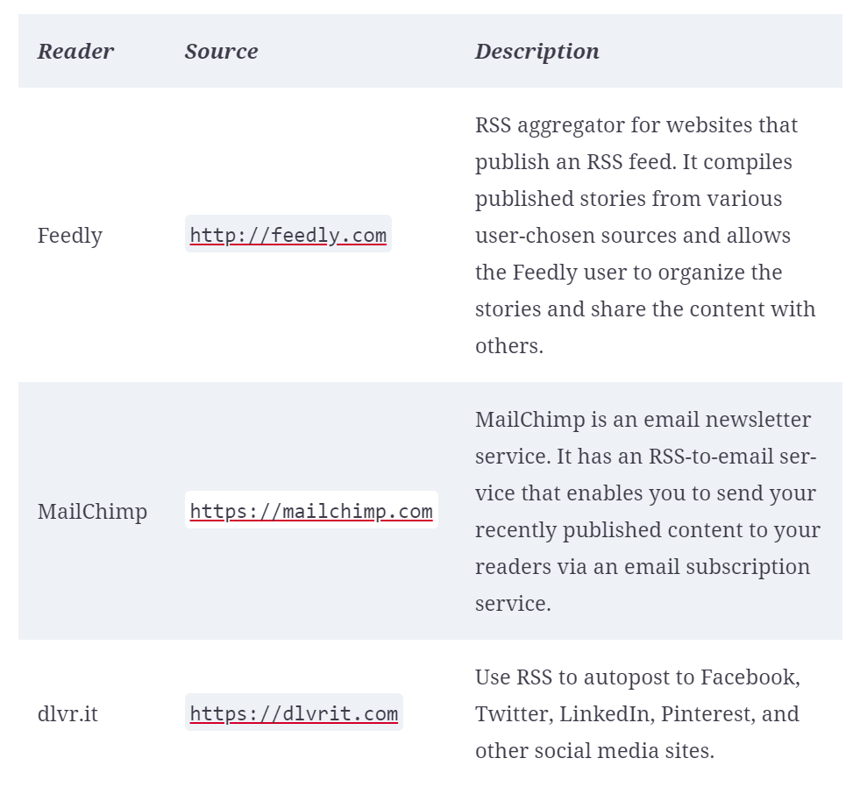
Popular RSS Feed Readers

Slide 17
…Cont.
For your readers to stay up to date with the latest and greatest content you post, they can subscribe to your RSS feed. WordPress RSS feeds are autodiscovered by the various feed readers.
The reader needs only to enter your site’s URL, and the program automatically finds your RSS feed.
WordPress has RSS feeds in several formats. Because the feeds are built into the software platform, you don’t need to do anything to provide your readers an RSS feed of your content.

Slide 18
Tracking back
The best way to understand trackbacks is to think of them as comments, except for one thing: Trackbacks are comments left on your site by other sites, not people. Sounds perfectly reasonable, doesn’t it? After all, why wouldn’t inanimate objects want to participate in your discussion?
Actually, maybe it’s not so crazy after all. A trackback happens when you make a post on your site, and within the content of that post, you provide a link to a post made by another author on a different site. When you publish that post, your site sends a sort of electronic memo to the site you linked to.
That site receives the memo and posts an acknowledgment of receipt in the form of a comment to the post that you linked to on the site.

Slide 19
…Cont. (2)
The information contained within the trackback includes a link back to the post on your site that contains the link to the other site — along with the date and time, as well as a short excerpt of your post.
Trackbacks are displayed within the comments section of the individual posts.

Slide 20
Dealing with comment and trackback spam
The absolute bane of publishing content on the Internet is comment and trackback spam. Ugh.
When blogging became the “it” thing on the Internet, spammers saw an opportunity. If you’ve ever received spam in your email program, you know what I mean.
For content publishers, the concept is similar and just as frustrating.

Slide 21
…Cont. (3)
Spammers fill content with open comments with their links but not with any relevant conversation or interaction in the comments.
The reason is simple: Websites receive higher rankings in the major search engines if they have multiple links coming in from other sites, like trackbacks.
Enter software like WordPress, with comment and trackback technologies, and these sites become prime breeding ground for millions of spammers.
No one likes spam. Therefore, developers of CMSes such as WordPress spend untold hours trying to stop these spammers in their tracks, and for the most part, they’ve been successful.

Slide 22
Using WordPress as a Content Management System
A content management system (CMS) is a platform that lets you run a full website on your domain.
This means that WordPress enables you to create and publish all kinds of content on your site, including pages, blog posts, e-commerce pages for selling products, videos, audio files, events, and more.
A blog is a chronological display of content — most often, written by the blog author. The posts are published and, usually, categorized into topics and archived by date. Blog posts can have comments activated so that readers can leave their feedback and the author can respond, creating a dialogue about the blog post.

Slide 23
…Cont.
A website is a collection of published pages with different sections that offer the visitor different experiences. A website can incorporate a blog but usually contains other sections and features. These other features include
Photo galleries
E-commerce stores
Discussion forums
Social communities
Portfolios
Feedback forms
Static pages (such as Bio, FAQ, or Services)

Slide 24
Why WordPress?
Using WordPress as a CMS means that you’re creating more than just a blog; you’re creating an entire website full of sections and features that offer different experiences for your visitors.

Slide 25
Exploring the World of Open-Source Software

Slide 26
IN THIS CHAPTER (2)
Check Exploring open-source concepts
Check Discovering examples of open-source projects
Check Understanding WordPress licensing
Check Applying WordPress licensing

Slide 27
Open-source software
Open-source software is a movement that started in the software industry in the 1980s.
Its origins are up for debate, but most people believe that the concept came about in 1983, when a company called Netscape released its Navigator web browser source code to the public, making it freely available to anyone who wanted to dig through it, modify it, or redistribute it.
WordPress software users need a basic understanding of the open-source concept and the licensing upon which WordPress is built because WordPress’s open-source policies affect you as a user — and greatly affect you if you plan to develop plugins or themes for the WordPress platforms.

Slide 28
Defining Open-Source
A simple, watered-down definition of open-source software is software whose source code is freely available to the public and that can be modified and redistributed by anyone without restraint or consequence.
An official organization called the Open-Source Initiative (OSI; https://opensource.org), founded in 1998 to organize the open-source software movement in an official capacity, has provided a very clear and easy-to-understand definition of open-source.

Slide 29
…Cont. (4)
Open-source software source code must be freely available, and any licensing of the open-source software must abide by this definition.
Based on the OSI definition, WordPress is an open-source software project.
Its source code is accessible and publicly available for anyone to view, build on, and distribute at no cost anywhere, at any time, or for any reason.

Slide 30
Understanding WordPress Licensing
Most software projects are licensed, meaning that they have legal terms governing the use or distribution of the software.
Different kinds of software licenses are in use, ranging from very restrictive to least restrictive.
WordPress is licensed by the GNU General Public License version 2 (GPLv2), one of the least restrictive software licenses available.

Slide 31
Applying WordPress Licensing to Your Projects
Regular users of WordPress software need never concern themselves with the GPL of the WordPress project at all.
You don’t have to do anything special to abide by the GPL. You don’t have to pay to use the WordPress software, and you aren’t required to acknowledge that you’re using the WordPress software on your site.
(That said, providing on your site at least one link back to the WordPress website is common courtesy and a great way of saying thanks.)

Slide 32
Next class
Review the Instructional Plan

